Slide 1
Wages
And
Gender
Efran Himel, Madelyn Nelson, Tiffany Quang, Isabelle Hauge

Slide 2
Background
Topic: Assess the impact of sex on wages after accounting for other variables and to produce a regression model for predicting wages.
Data from the 1985 Current Population Survey
Examines the impact of sex on wage while taking into consideration possible confounding variables.

Slide 3
Our Data
245 out of the 534 observations were females
The average wage for the observed females was $7.88 per hour
289 out of the 534 observations were males
The average wage for the observed males was $9.99 per hour
This is a difference of more than $2 per hour!

Slide 4
Variables
We couldn’t say that the difference in wages between males and females was strictly based on their sex, so the data includes other variables that may affect wages
Education - number of years of education
South - qualitative variable indicating whether or not the person lives in the South (1 = person lives in the South, 0 = person lives elsewhere)
Experience - number of years of work experience
Union - whether or not the person is a union member (1 = union member, 0 = not a union member)
Age - in years
Race - variable indicating person’s race (1 - other, 2 - Hispanic, 3 - White)
Occupation - occupational category ( 1 - management, 2 - Sales, 3 - Clerical, 4 - Service, 5 - Professional, 6 - Other)
Sector - sector of work (0 - other, 1 - manufacturing, 2 - construction)
Marr - marital status (0 - unmarried, 1 - married)

Slide 5
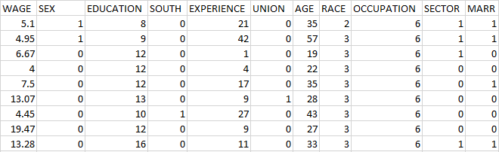
Data Overview
Here’s a snapshot of the table of data we worked with.

Slide 6
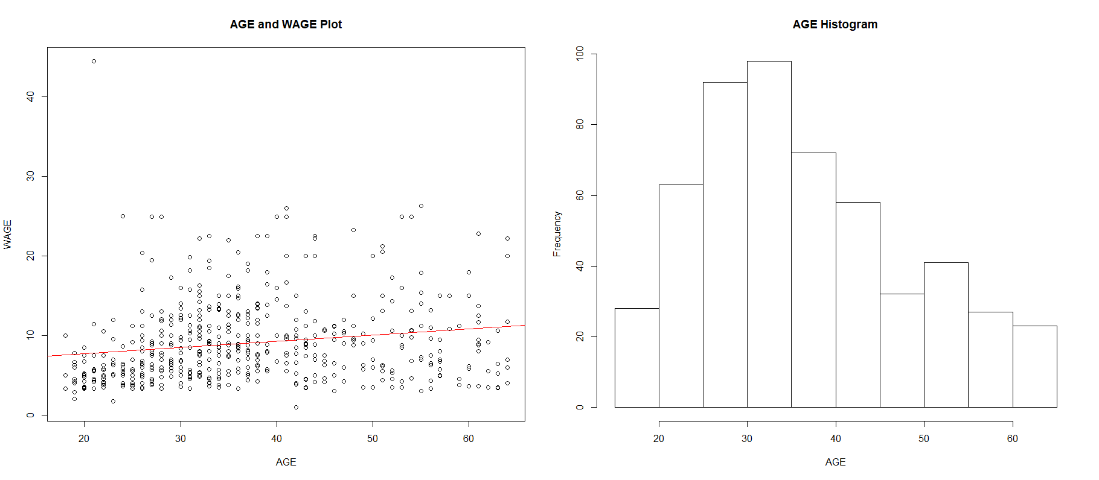
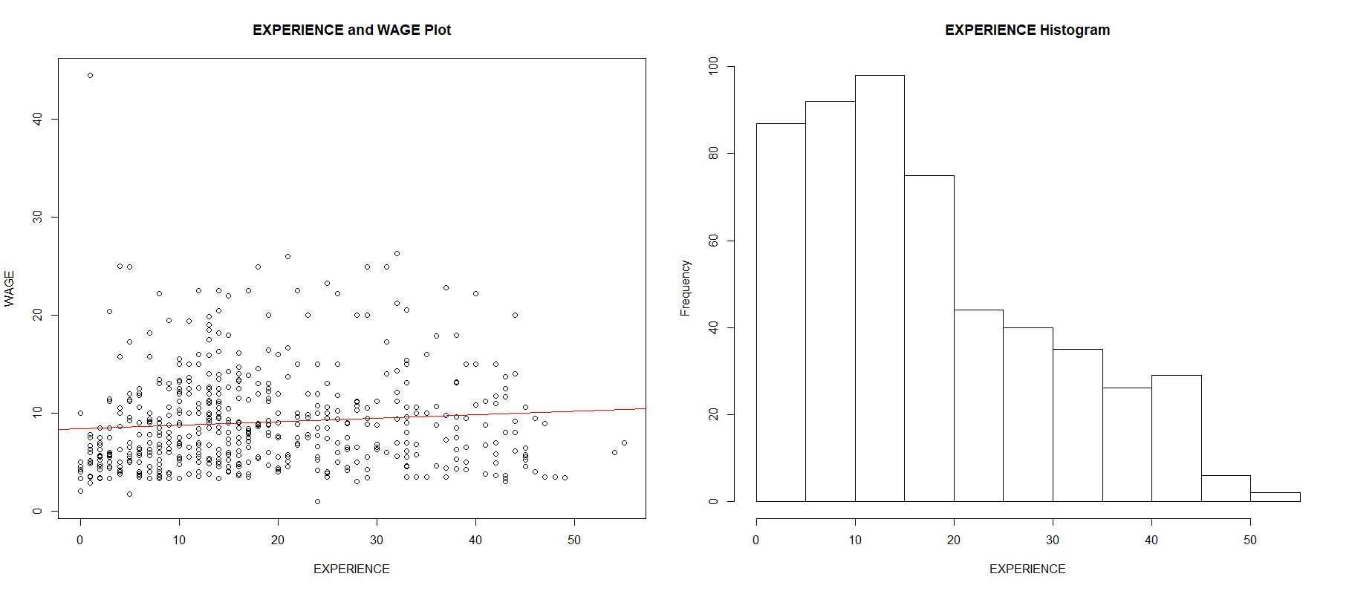
Exploring Data
Plotted all X variables against our Y variable (wage) to gain a general idea of the distributions of the X’s against Y.
Regression and histograms were also utilized for initial analysis of outliers and linear relationships with Y.
Afterwards we hypothesized the X values South, Sector and Marriage may be the least impactful variables.

Slide 7
Developing Models
Produced residual plots for collinearity and Q-Q plots for examining the normality of quantitative data (Age, Experience, Education, Wage)
We also used BIC and AIC algorithms to hone in on the variable combinations with the highest predictive capacity and cross validation to test robustness
Findings:
Some of our variables did not seem to be normal
Sex was present in all the highest scoring BIC AIC models which indicated to us it may have a strong importance in understanding wage
Other prominent variables in all our models highest scoring models: Education, Sex, Union, Age/Experience
All BIC AIC models performed poorly in cross validation which could indicate there are more key variables at play in determining wage or our data is too small

Slide 8
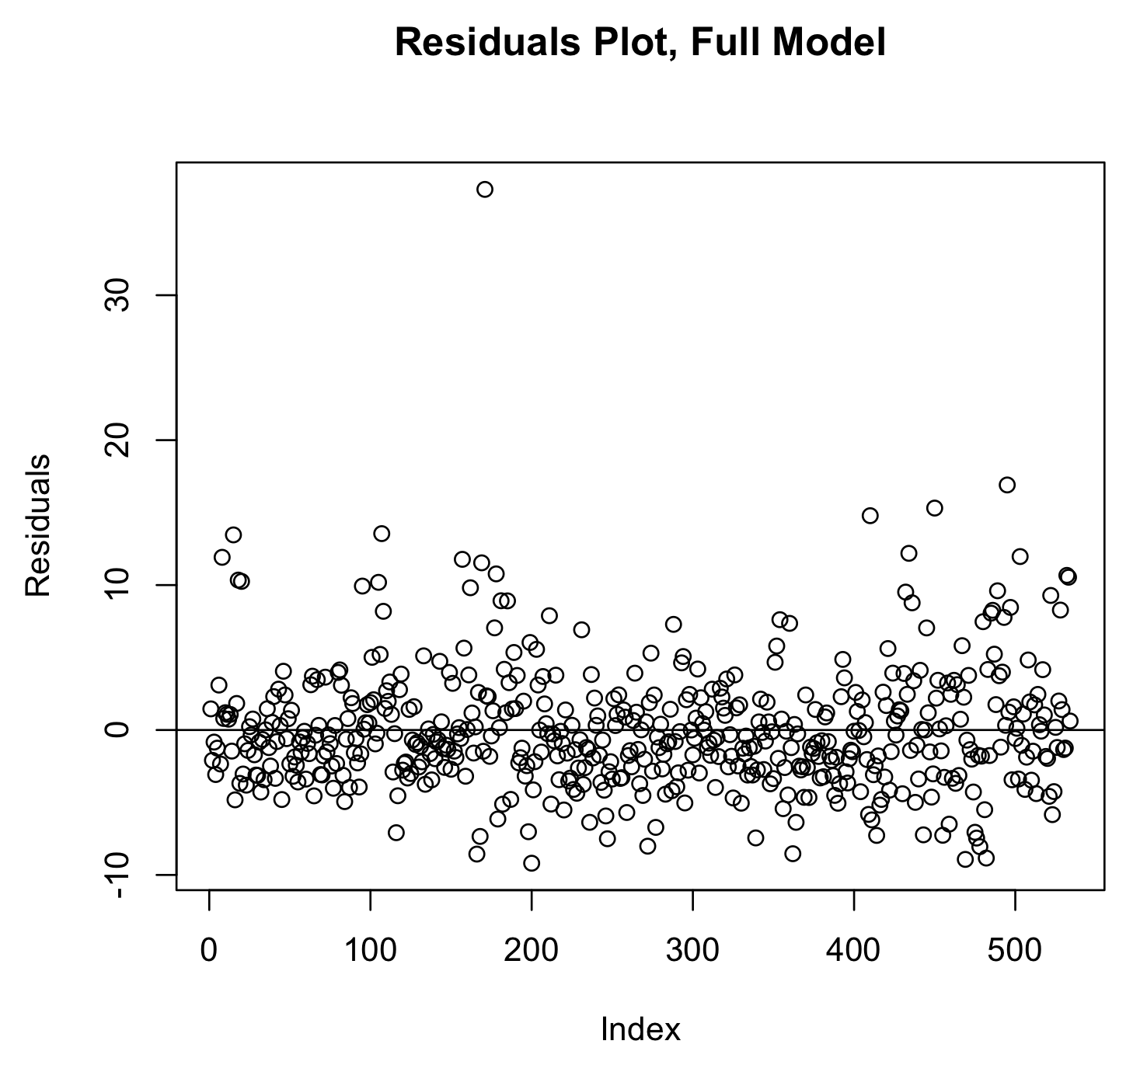
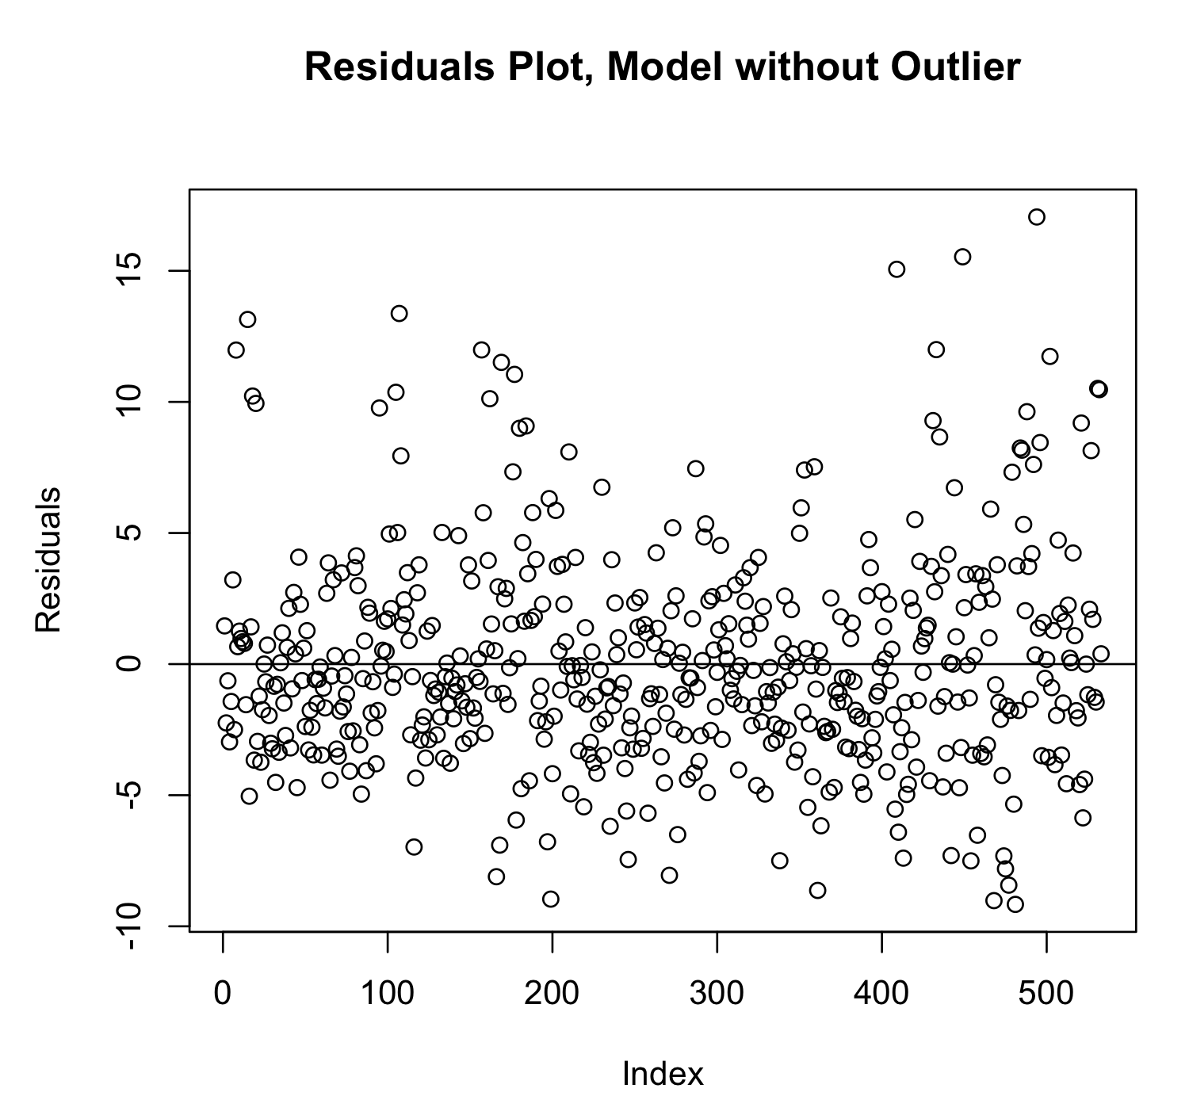
Removing the Outlier
During our preliminary data exploration, we discovered that there was one outlier that was significantly different from the rest of the data, so we decided that we should consider removing that data point for the purpose of our study.

Slide 9
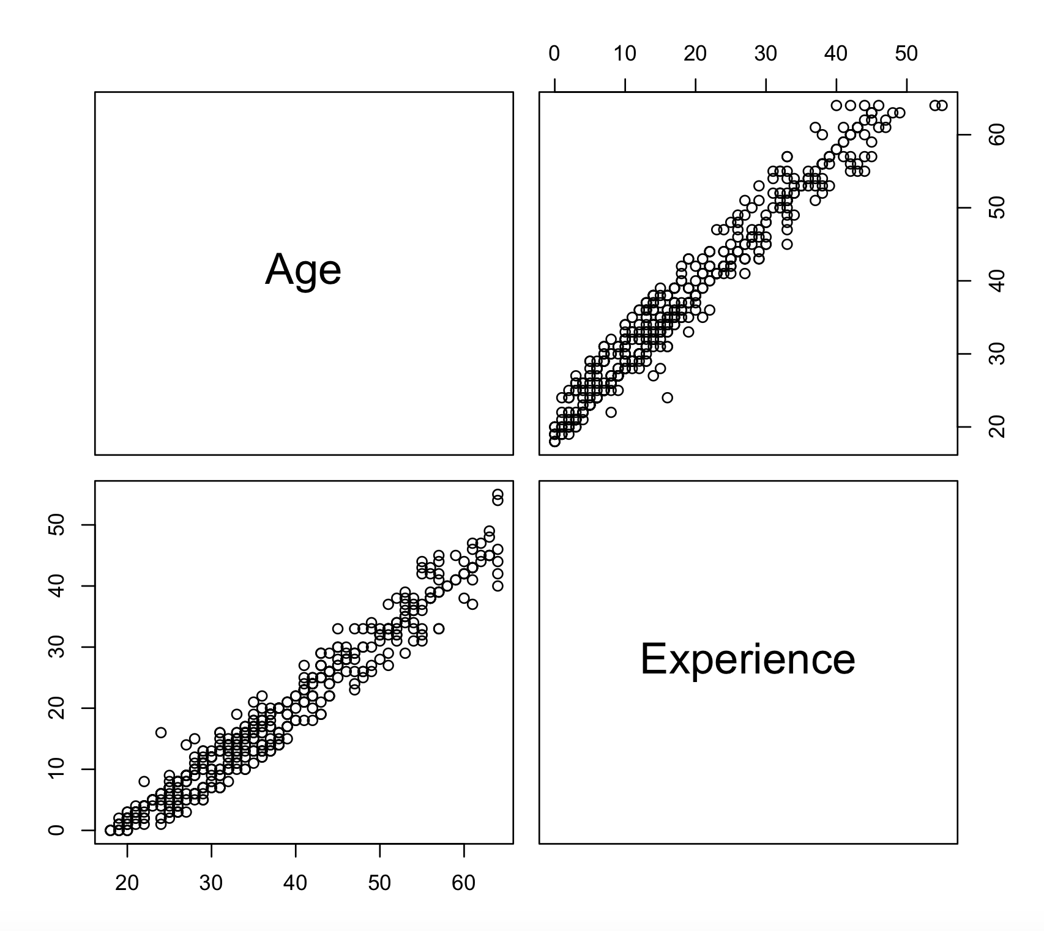
Collinearity
Using the pairs() function in R, we found that Age and Experience had a high correlation of 0.977885.
Due to this fact, we decided that our final model would only include one of these variables.
We had to do more testing to decide which one of these variables would remain in the model.

Slide 10
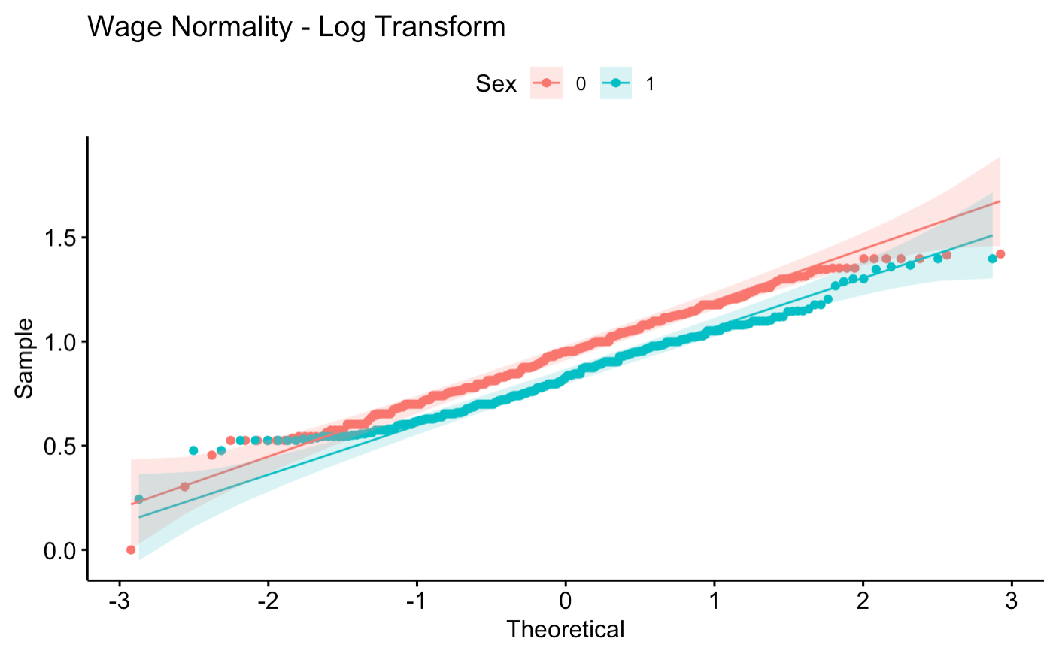
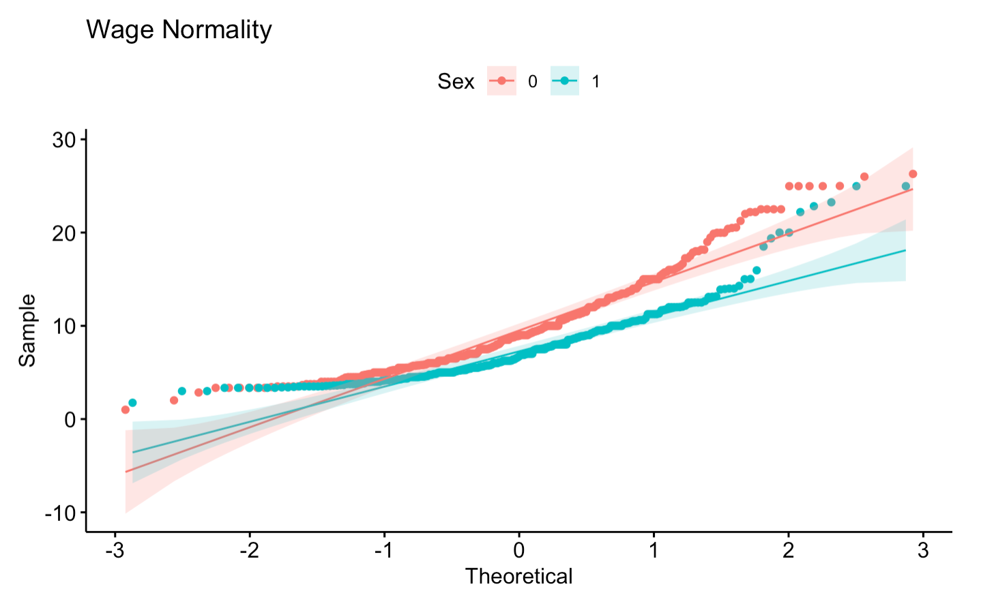
Log Transformation of Wage
When we looked at the Q-Q plots of the quantitative variables, we found that our wage variable showed a right skew on the normality plot.
We tried a log transformation of this variable, and the new Q-Q plot showed much less of a skew, so we decided that this was something to consider when testing.

Slide 11
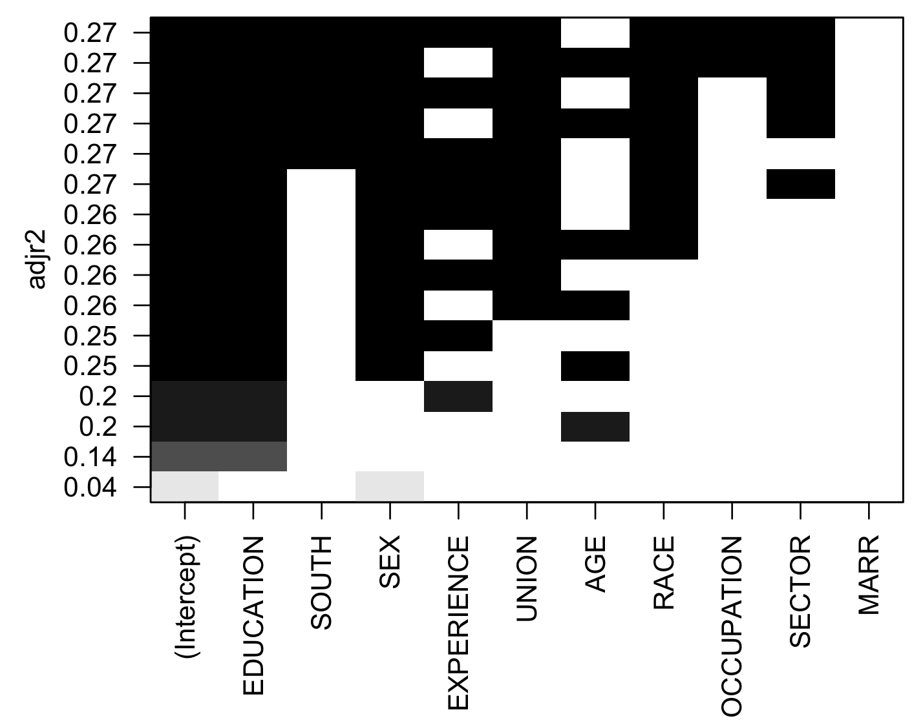
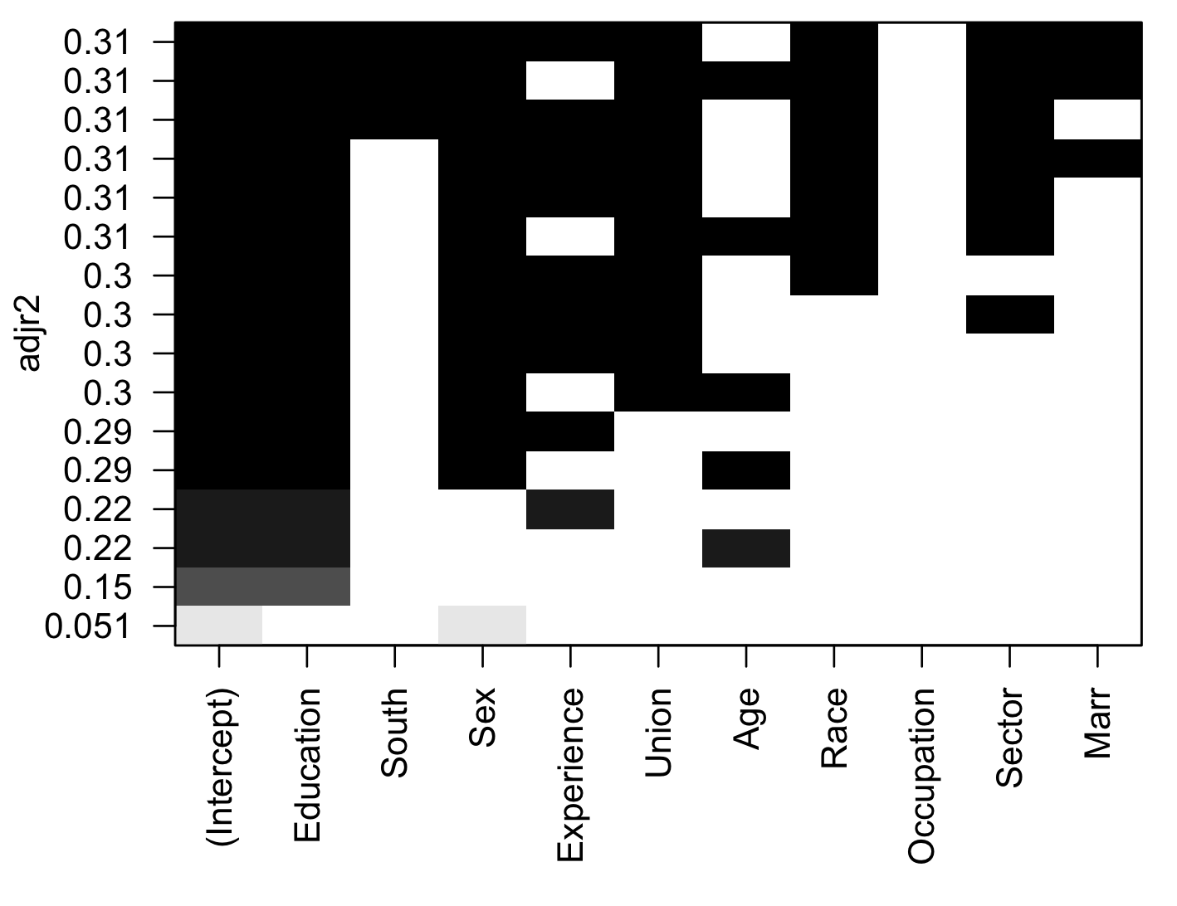
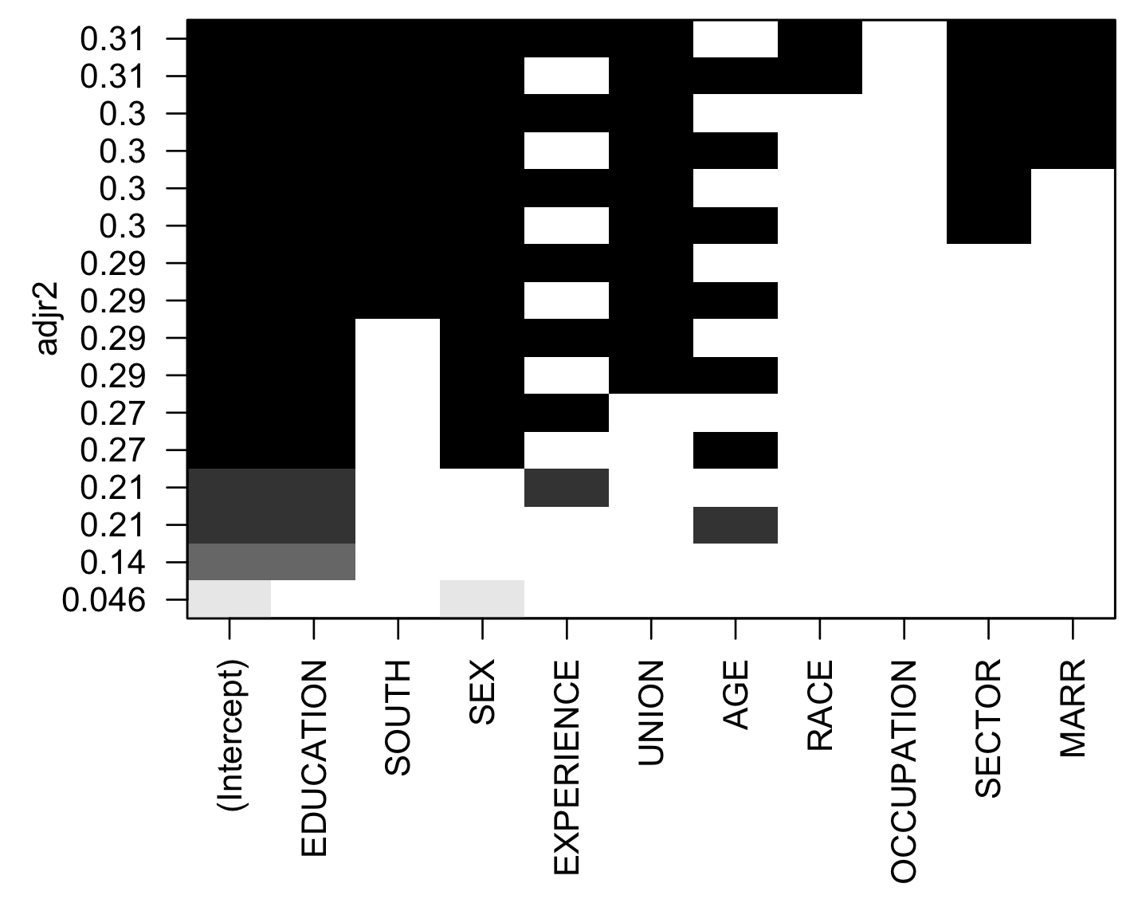
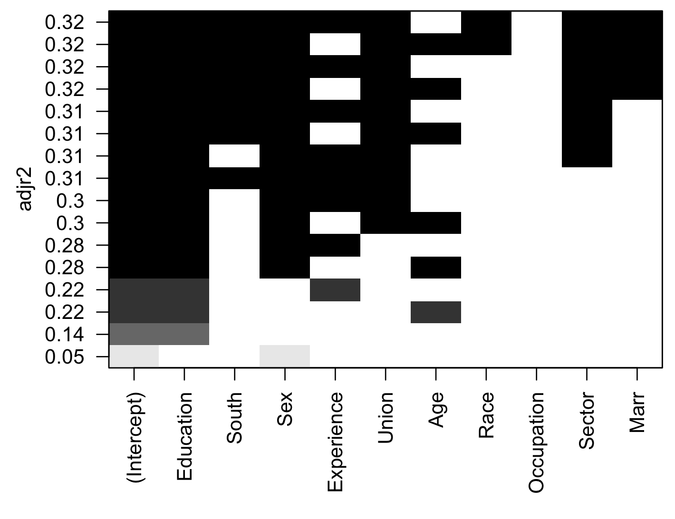
Adjusted R-Squared Testing
Outlier
No Outlier
No Log Transform
Log Transform

Slide 12
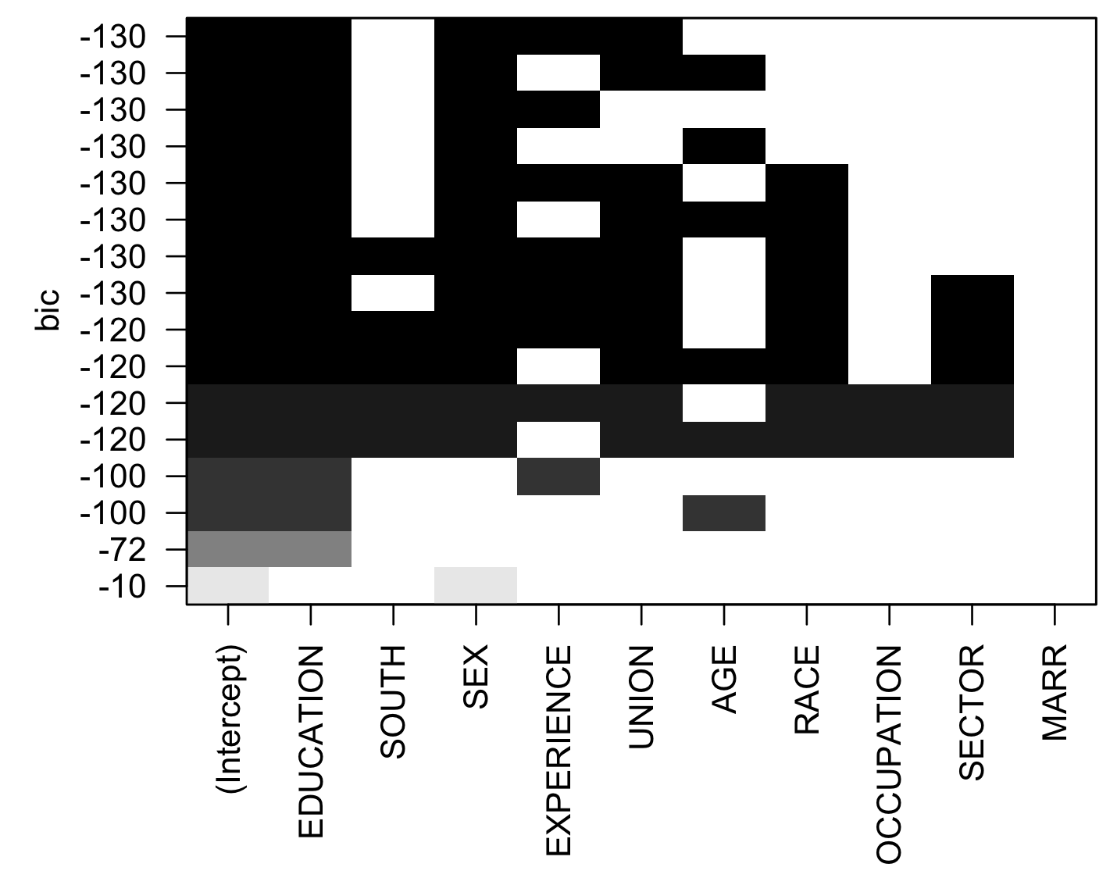
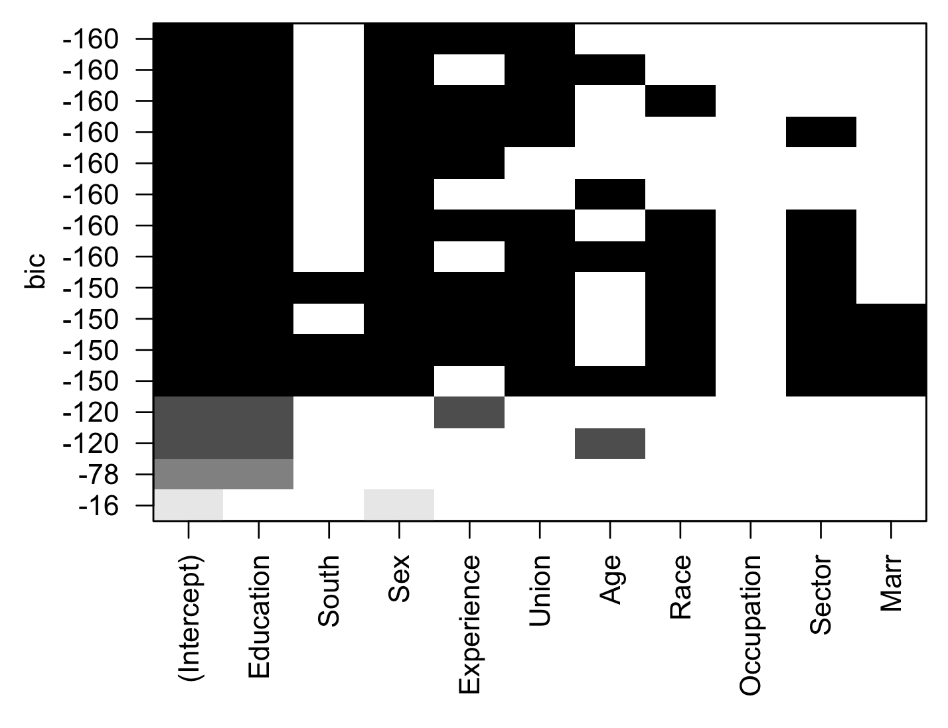
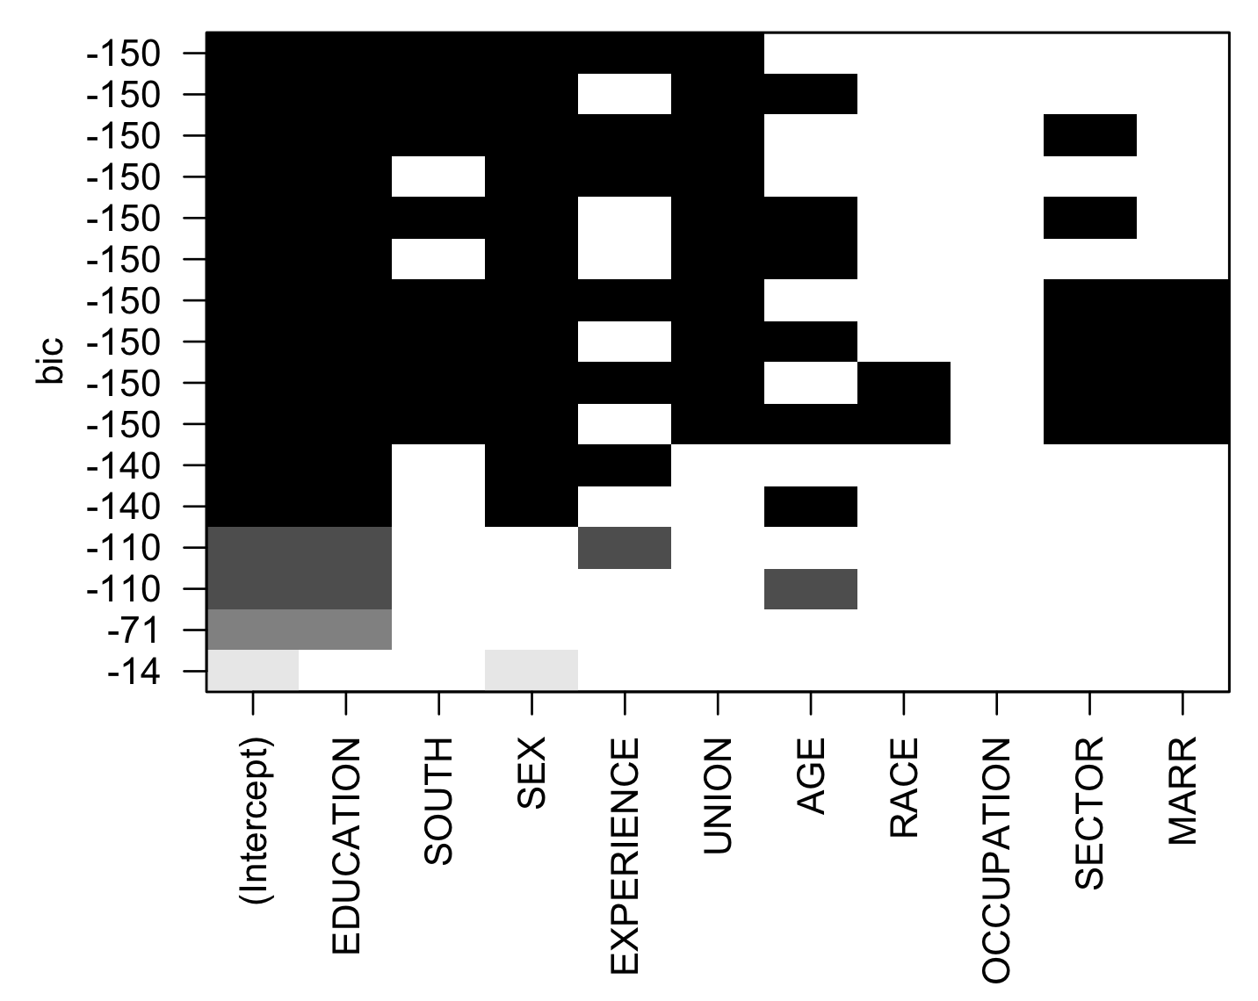
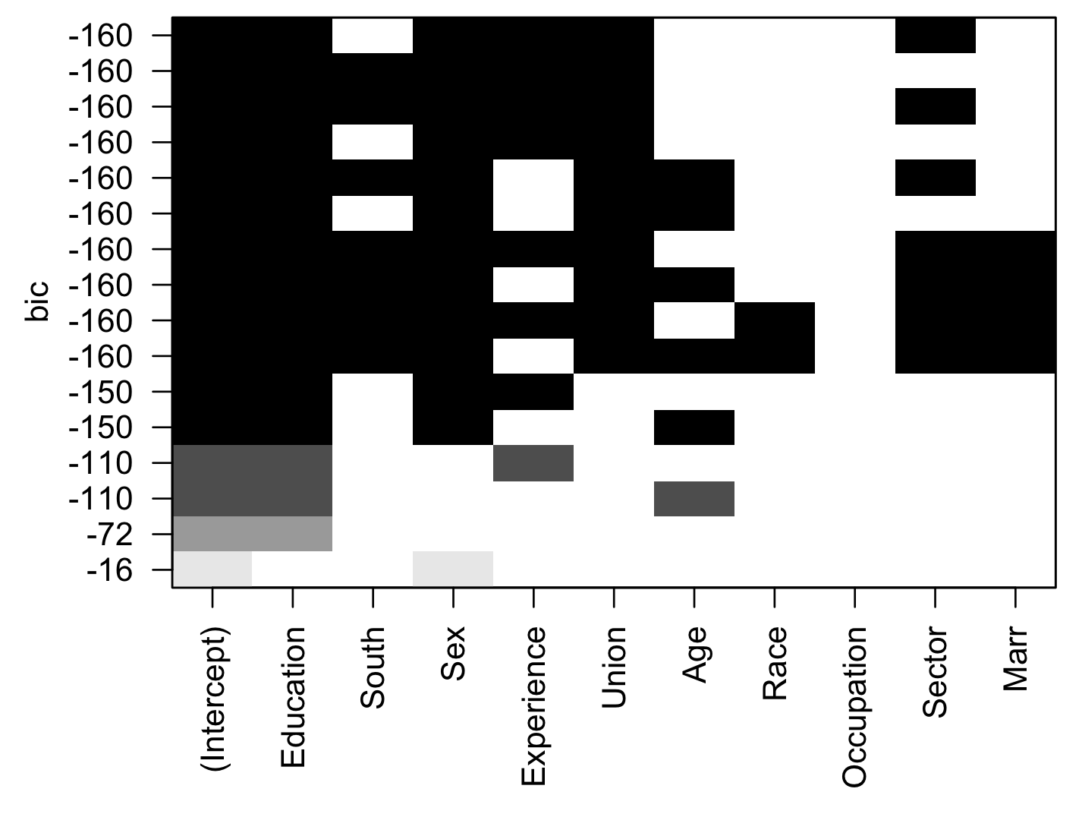
BIC Testing
Outlier
No Outlier
No Log Transform
Log Transform

Slide 13


Choosing Model Based on VIF
We want to find which multicollinear variable (experience or age) to include in our regression model.
log(Wage) ~ Age + Education + Sex + Union
log(Wage) ~ Education + Sex + Union + Experience
The model including age has VIFs values closer to 1, which is what we want.

Slide 14
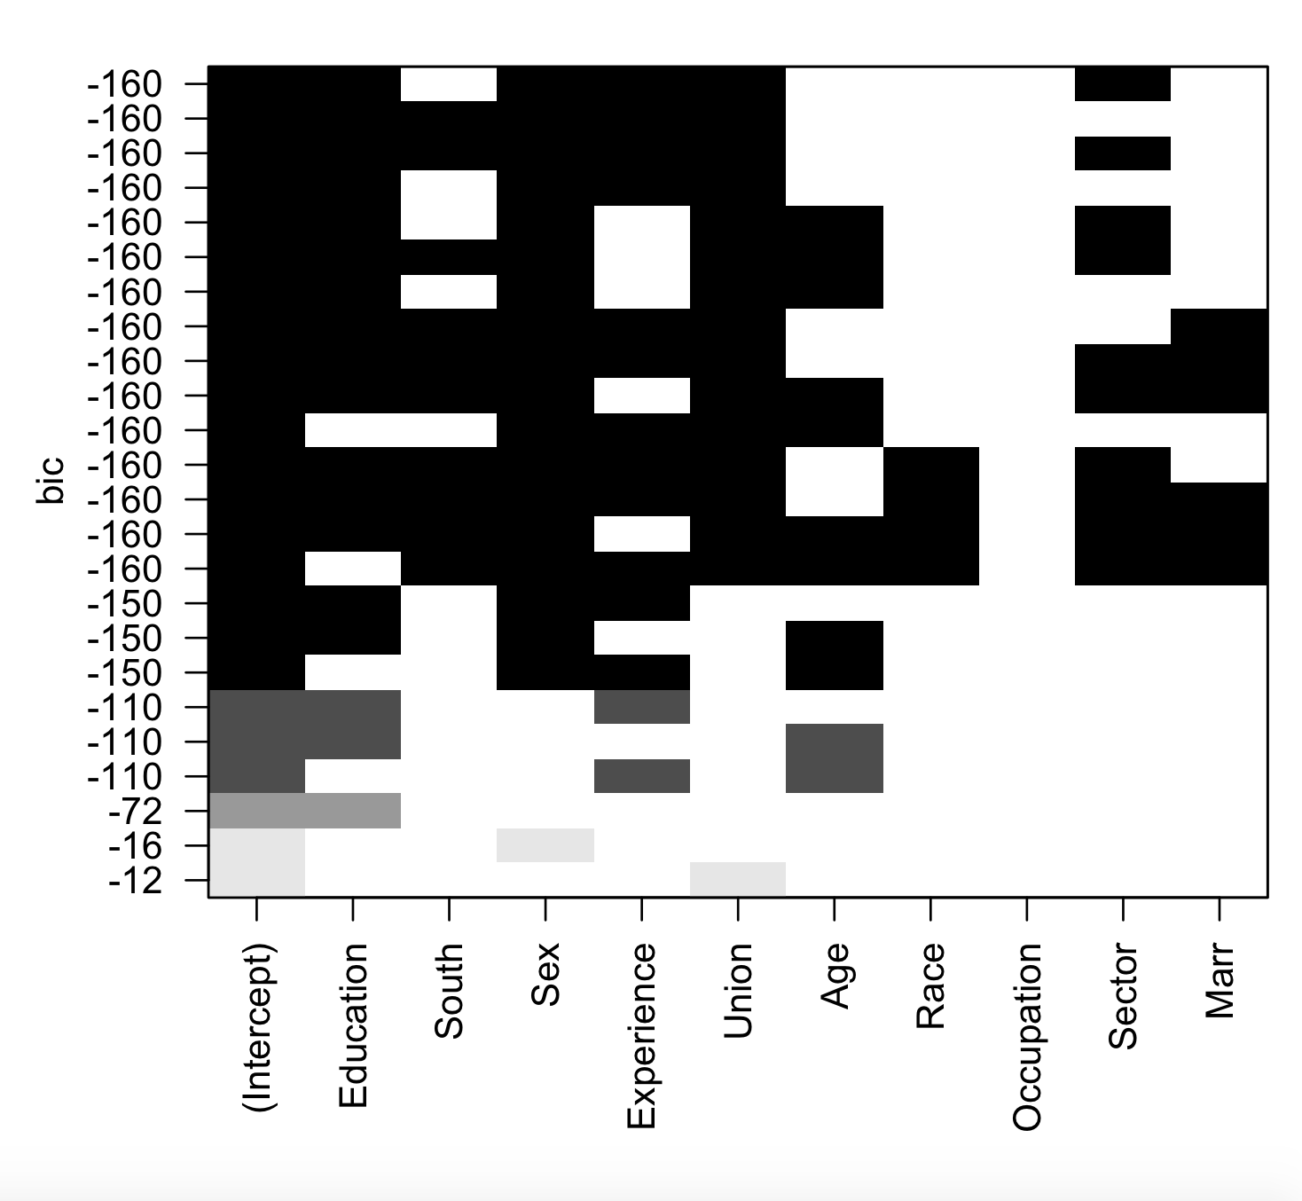
Improving Model Based on BIC
The BIC values suggested that the variable Sector could be added to our model after we performed a log transformation and removed an outliers.
We were not sure if we should include an additional variable as the model could become overfit.

Slide 15
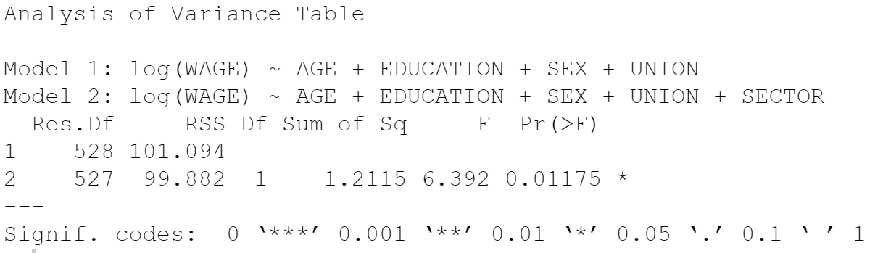
ANOVA Test
We performed an ANOVA test to determine whether or not to include Sector to our original model:
Null Hypothesis: The model without Sector is a better performing model.
alpha = 0.05
With a p-value = 0.01175, we reject the null hypothesis and are 95% confident that adding Sector to our model significantly improves it.

Slide 16
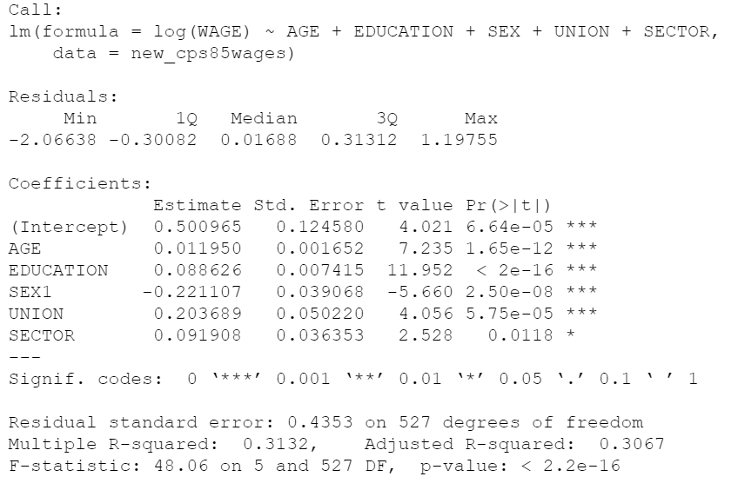
Analysis of Summary Output
Regression Model:
log(Ŷ) = 0.500965 + 0.011950(age) + 0.088626(education) - 0.221107(sex) + 0.203689(union) + 0.091908(sector)
Based off of our study’s population, we received a negative β value for our variable Sex. We can interpret this as sex possibly having a negative impact for women, as the qualitative placeholder values was 0 for male and 1 for female.

Slide 17
Conclusion
In our data from 1985, we found sex is an important predictor variable in the model we chose to predict wage.
In our model, sex has a negative coefficient which indicates that being female could have a negative impact on wage.
Using log transformations of our data allowed us to produce our models by making our data follow a normal distribution
Learning Outcomes:
Deeper appreciation for slowly analyzing data and building a the best fit model by understanding features of the data set
Algorithmic methods are useful to honing in models of potential interest
Although our findings are interesting, we can’t make any sweeping general statements given the scope and limitations of our data and tests

